Slide 1
Ground Station and
Satellite Tracking System
A Western CubeSat Project
Notes:
Introduction of self and our project title

Slide 2

Problem statement
Problem
Statement
To design and build a functional satellite tracking ground station
Westen’s CubeSat Project lacks an accessible ground system that can maintain communication with the satellite
Notes:
Annie
The problem statement is that the we need to design this fucntion satellite tracking ground station, motivation is that the western cubesat team needs one to complete their research as the GS will be the connection point between the cubesat in orbit and the mission control team on the ground.

Slide 3
Progress
Several iterations on design
Finalized and ordered materials
Stepper motor initialization
Notes:
Annie

Slide 4
Concept
Square poles
Thrust bearing for azimuth motor
160:1 gearbox for elevation motor
Sheet metal housing for base

Slide 5
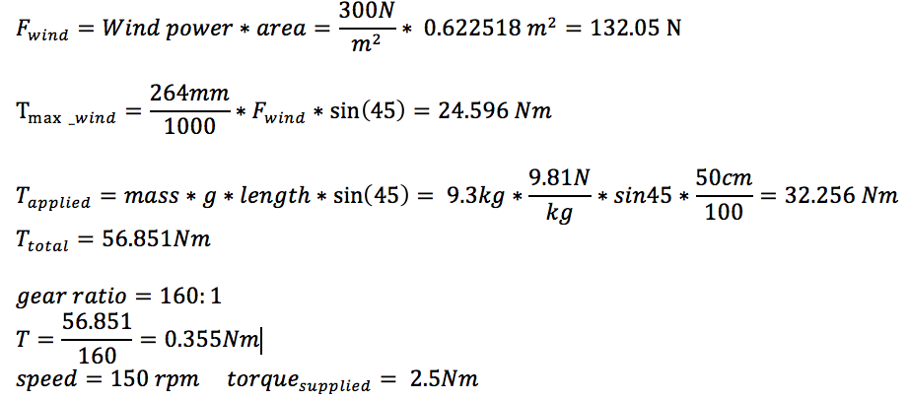
Torque Calculations

Slide 6


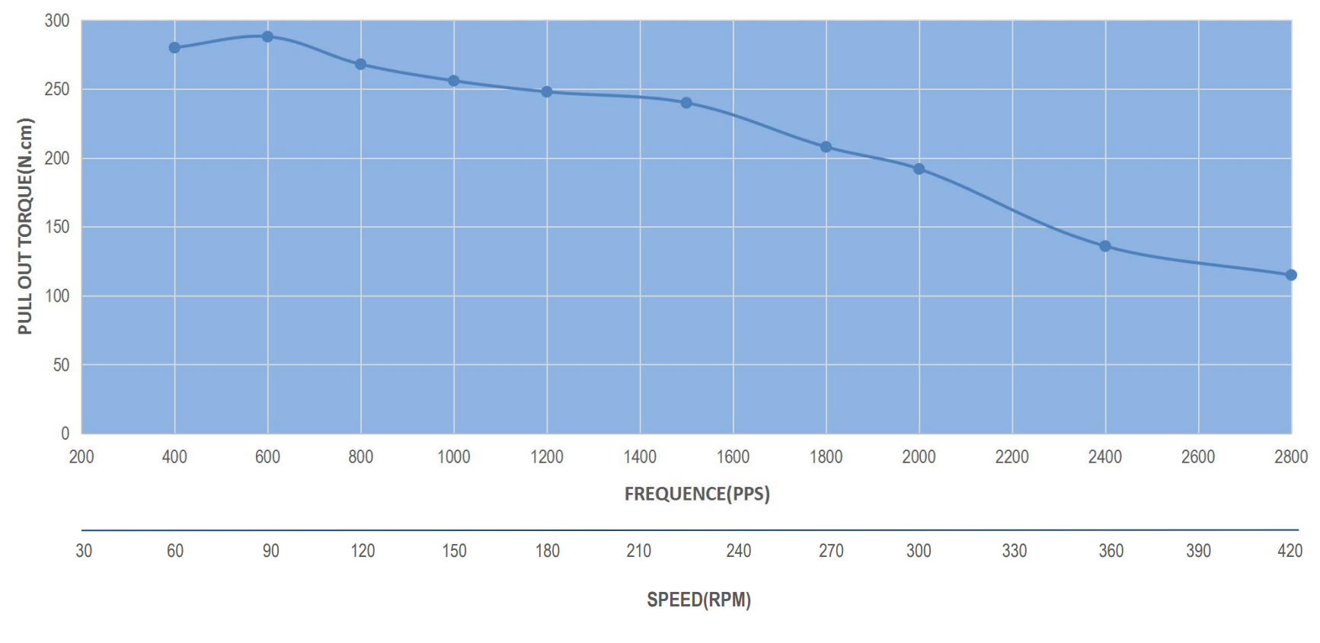
Torque Calculations
~

Slide 7
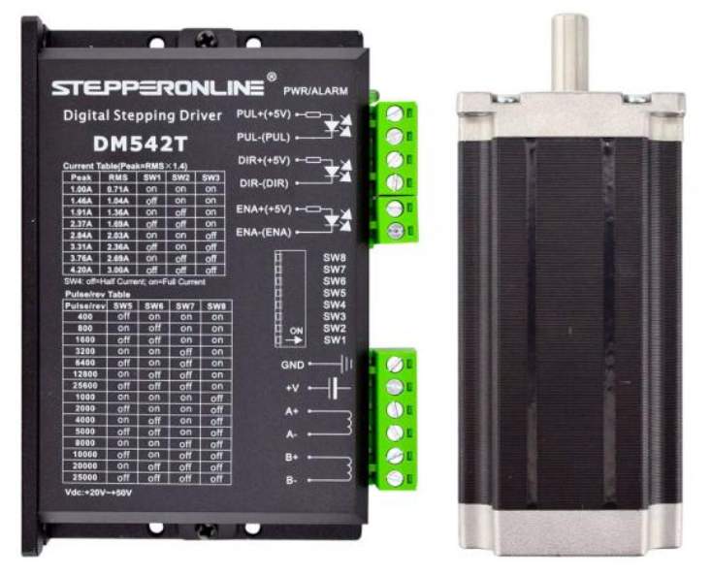
Motor + Motor Driver
 | Nema 34 | Nema 23 | Nema 17
Holding Torque | 7.07 Nm | 3.0 Nm | 0.6 Nm
Step Angle | 1.8 deg | 1.8 deg | 1.8 deg
Operating Voltage | - | 4.2 V | 10 V
Weight | 3.13 kg | 1.6 kg | 0.5 kg
Cost | $125.92 | $49.86 | $34.09

Slide 8
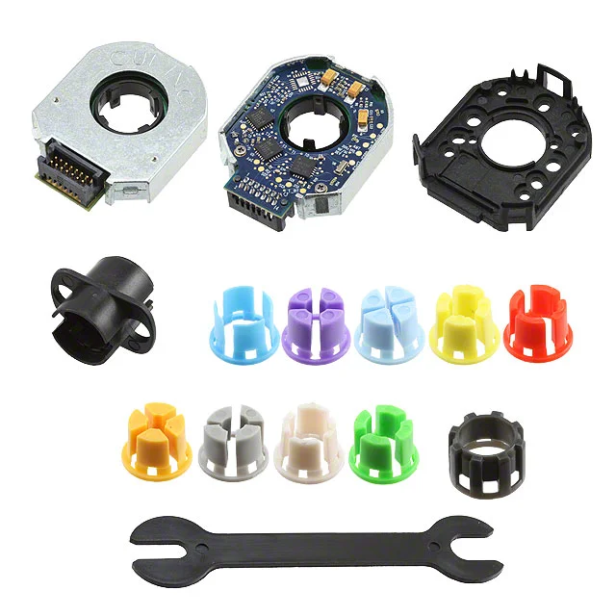
Encoder
 | Cui AMT20 Series | Broadcom AR18 Series | HEDM-55xx
Encoder Type | Absolute | Optical | Optical
Resolution | 0.08˚ (12 bits) | 1.4˚ (8 bits) | 0.35˚
Accuracy | ±0.2˚ | ±0.2˚ | -
Serial Protocol | SPI | SSI 3-Wire | SPI 3-Wire
Maximum Speed | 8000 RPM | 15000 RPM | 30000 RPM

Slide 9
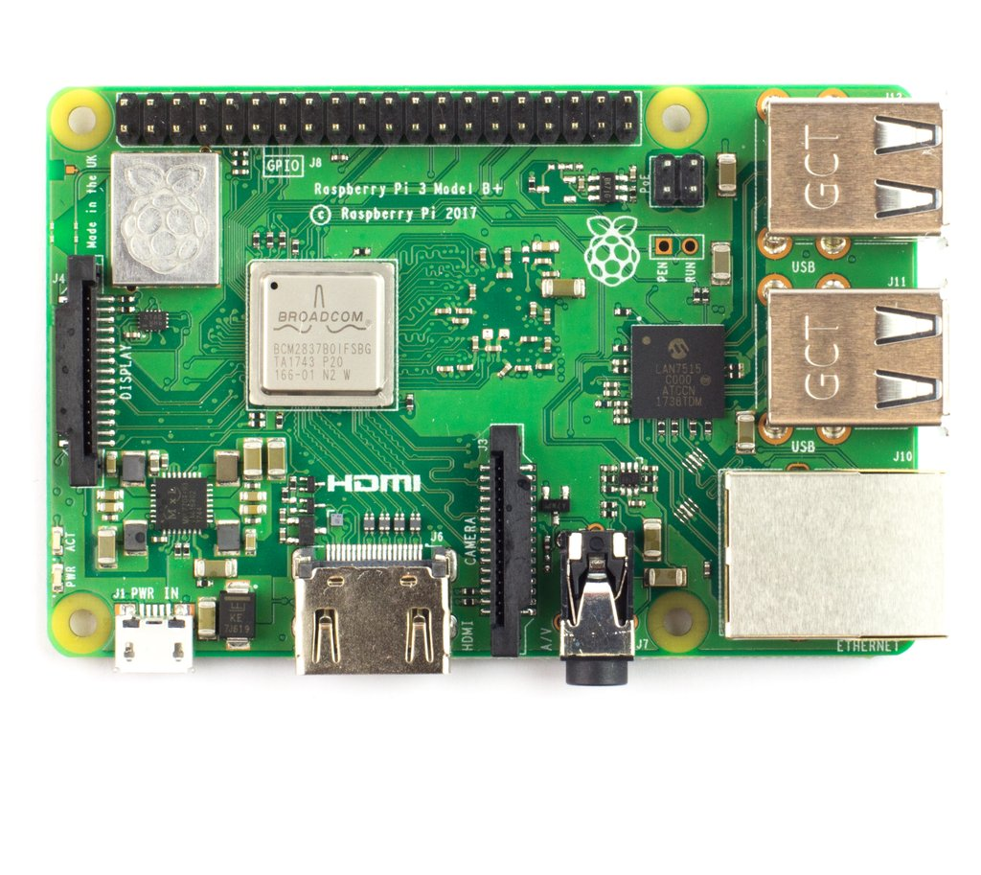
Onboard
Computer
 | Raspberry PI 3B+ | Arduino Uno | PIC Microcontroller
RAM | 1 GB | 2 KB | 256 KB
Flash Memory | - | 32 KB | 1 MB
IO Pins | 40 | 20 | 62
Clock Speed | 1.4 GHZ | 16 MHz | 180 MHz
Internet Capabilities | Yes | No | No
Cost | $50 | $25 | $30 (w/o headers)

Slide 10
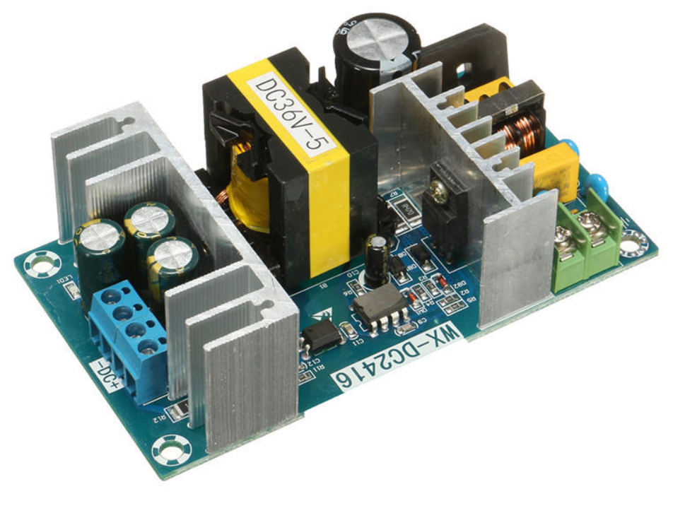
AC-DC Converter Module
Input Voltage: 100-240 VAC
Output Voltage: 36 VDC
Output Current: 5-6.5 A
Cost: $23.99

Slide 11
Software Updates
Preliminary architecture for stepper motor control
General satellite positioning using Python’s SGP4 library
Working on dynamic tracking based on Two Line Elements
Notes:
flow

Slide 12
Problems Encountered
Gearing the motors
Power conversion and distribution
Timeline
Budget

Slide 13
What next?
Build base
Test with stepper motors
Continue algorithm design and iterative testing
Assemble as components come in

Slide 14
Questions?

Slide 15
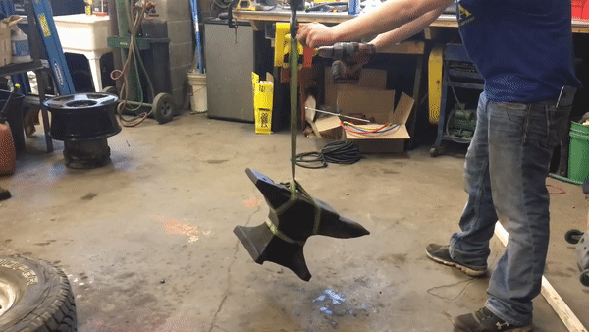
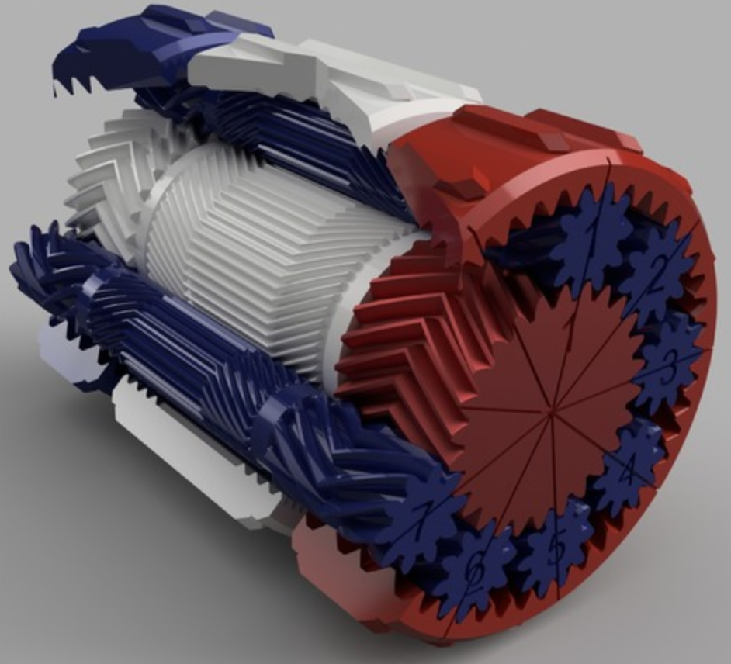
Appendix 1
Gearbox In Action

Slide 16
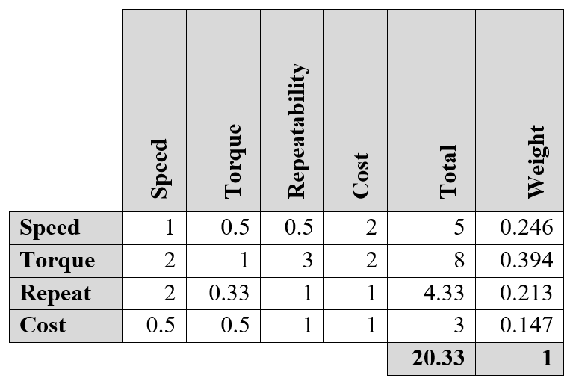
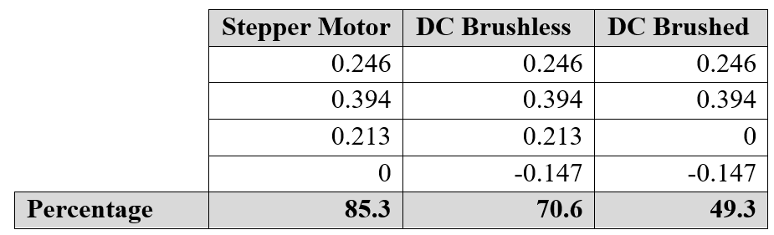
Appendix 2
Decision matrices for actuation system

Slide 17
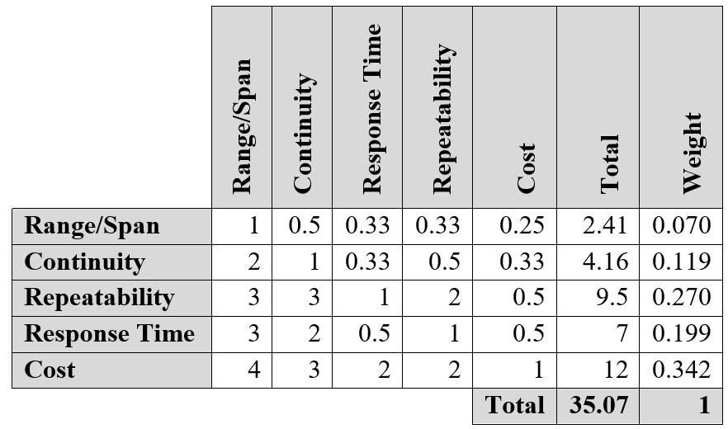
Appendix 3
Decision matrix for encoder

Slide 18
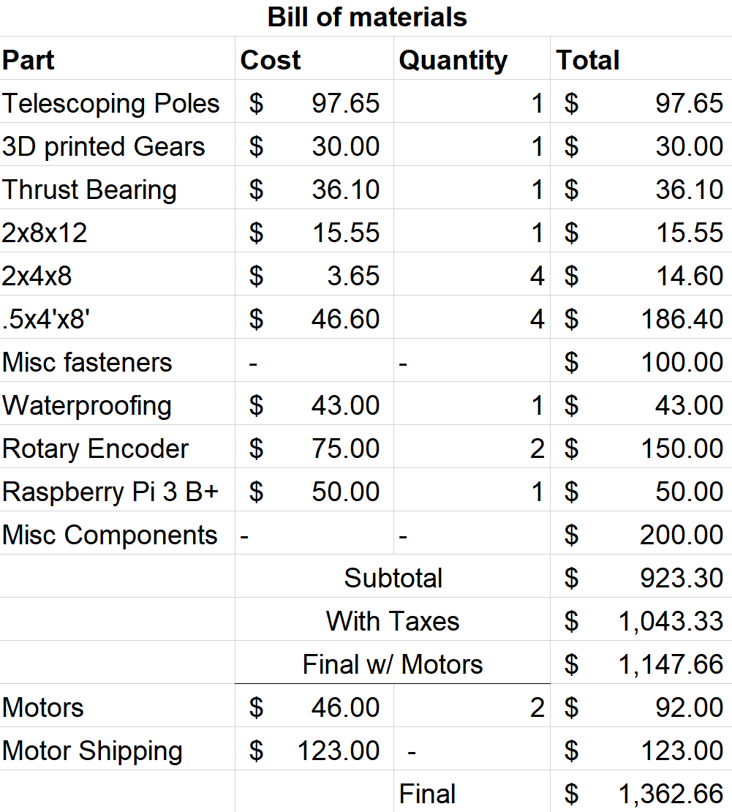
Appendix 4
B.O.M.

